Slide 1
LA Parking Violations
with Team 8: MadSidHelKat
Sid Desai | Madeline Glasheen
Katie Newman | Heloisa Walsh

Slide 2
Beginning our drive…
Why parking citations?
What are we asking?
Thanks, Kaggle!
Parking issues impact two major parties –
city government and its residents
Could there be correlations between types of cars and citations?
Is there a time you are more likely to receive a ticket?
What areas are the most notorious for doling out tickets?
9.19 M records
As early as October 2014
Updated daily
Violation code, dates, location coordinates

Slide 3

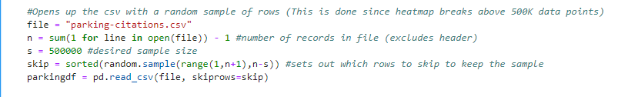
The Data Roadwork
Sample of 500K (out of 9.2M) rows from the CSV
Nonessential columns were dropped and then all rows with missing data were dropped as well
Any rows that included a Latitude or Longitude value of 99999 were dropped
Validated left were checked to ensure that there was a robust enough dataset left after all of the removals - on average, the remaining dataset retained ~450K records
Notes:
Set up how we broke out the work
Sid to take clean up details

Slide 4
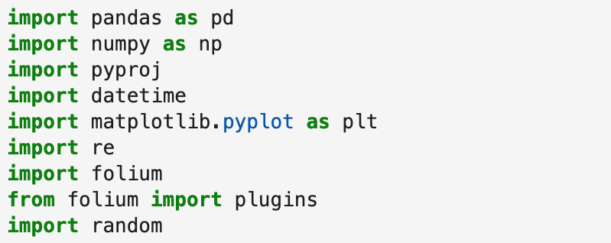
Libraries
Notes:
Check out all the libraries we used. The more the merrier.

Slide 5
Our Results

Slide 6
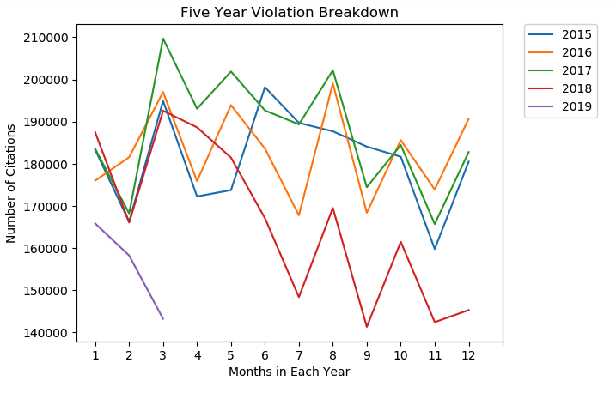
LA Violation Trends over the years
Peak ticketing in March
Increased in May and August
Marked revenue decline starting June 2018
2019 continues revenue decline
Notes:
Heloisa

Slide 7
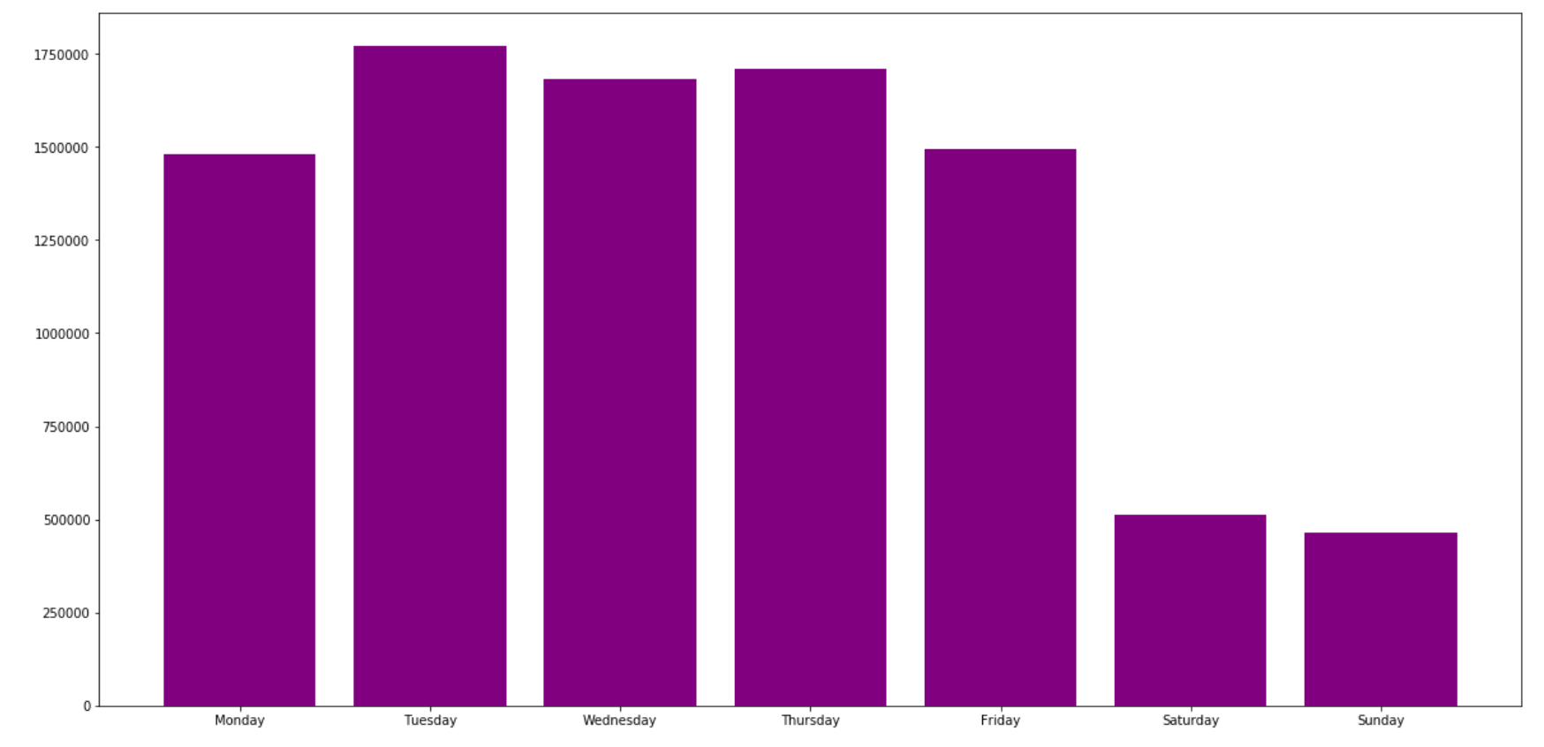
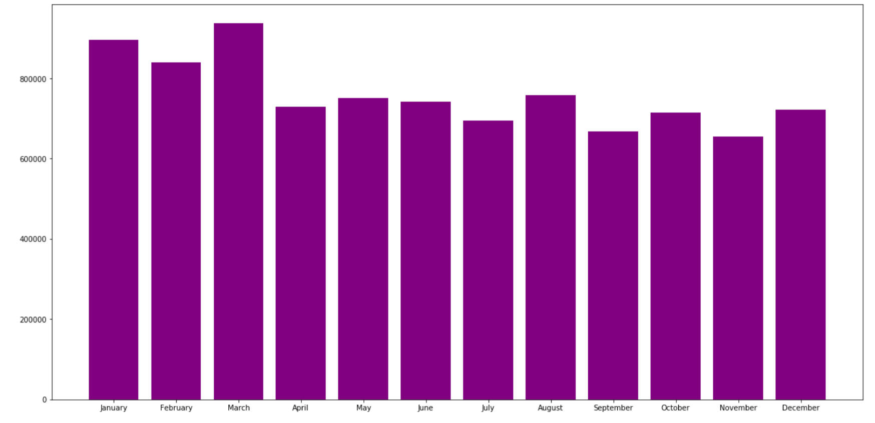
When are you most likely to get a ticket?
Notes:
Heloisa

Slide 8
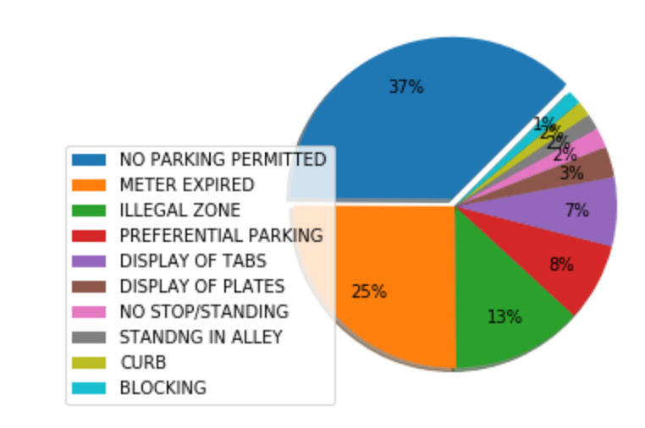
LA Violation Types by frequency
Violation description standardization
Use industry knowledge to group citation titles
~90% of parking violations are in the top 10 most-common violations
Notes:
Katie
“Sweep”
Standardizing codes
90% of records fall in top 10 categories

Slide 9
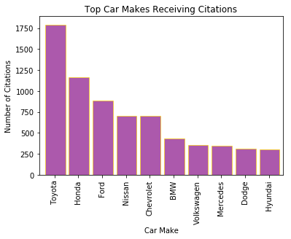
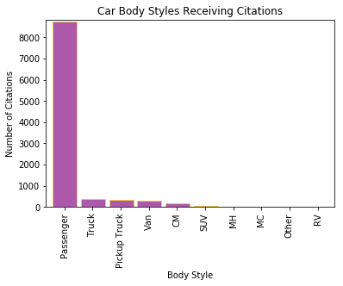
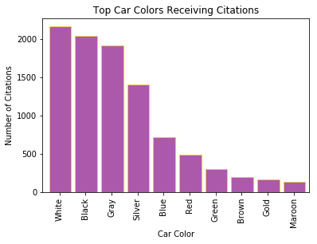
Do certain car types receive more citations?
By Car Makes
Japanese cars top the list.
By Car Body Style
Most cited vehicles appear to be passenger cars - no key legend to distinguish.
By Car Color
White, black, and gray cars were the most ticketed.

Slide 10
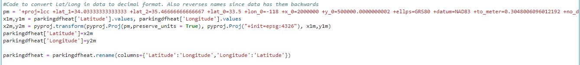
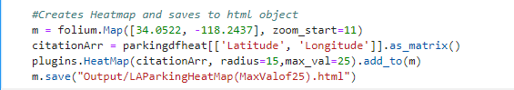
LA Parking Citation Heat Map
To create the heatmap, a blank map of LA was created in folium first.
The Lat/Long values were converted into a matrix that was then used in the HeatMap function in folium.
The maximum intensity value for the heatmap was set to 25, meaning that 25 citations in an area yielded the darkest coloring.
The folium heatmap has the functionality to zoom in and out, and the intensity levels are averaged at farther zoom levels to allow the maximum intensity to remain relevant at all zoom levels.

Slide 11
Conclusion
The Truths
We believe…
More likely to get tickets during business hours and weekdays due to influx of commuters
Most parking violations are due to parking in illegal areas
Ride sharing impacting city revenues
Lack of standardized codes for violation issue, car body style, colors for parking enforcement is leading to poor data collection
LA residents are frustrated with lack of parking options and thus parking in metro areas less frequently, which are missed revenue opportunities for the city.

Slide 12
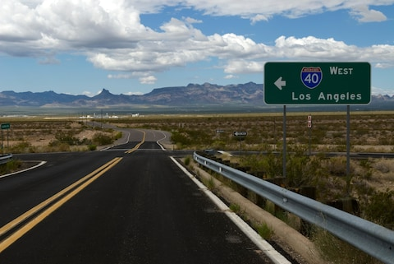
Down the road…
Overlay with ride sharing data
Car registration data
Time of day scatter plots
Demographic information about groups that are more subject to parking tickets

Slide 13
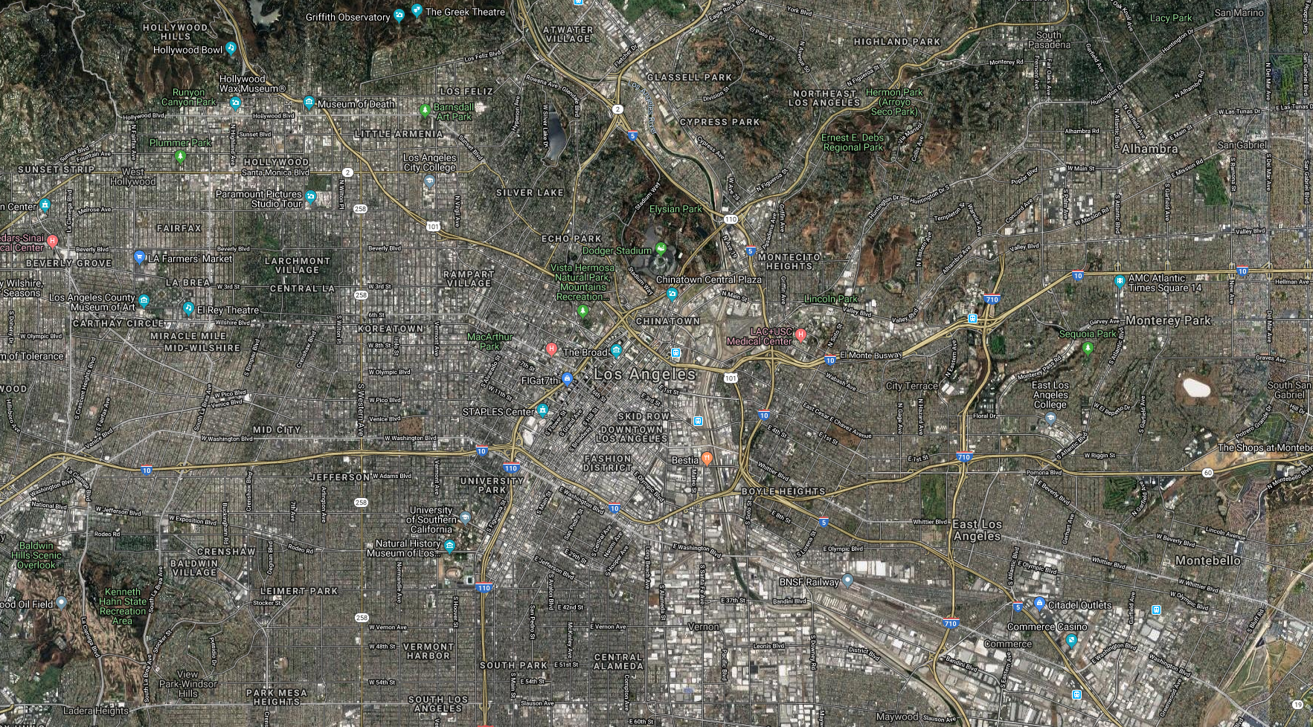
Thank you!

